Slide 1
Docking of AKR with RCC

Slide 2
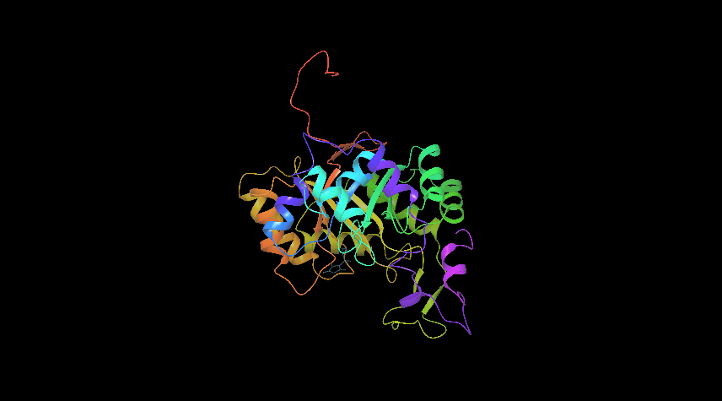
Os05t0474600 Protein

Slide 3
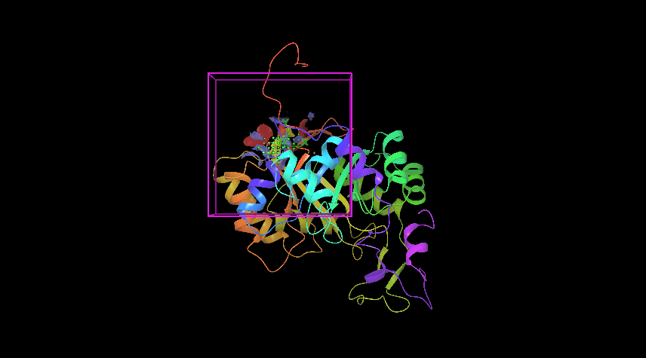
Os05t0474600 Active site 1

Slide 4
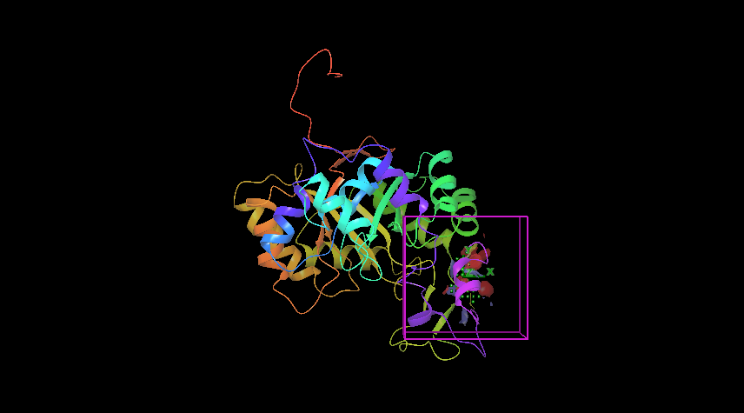
Os05t0474600 Active site 2

Slide 5
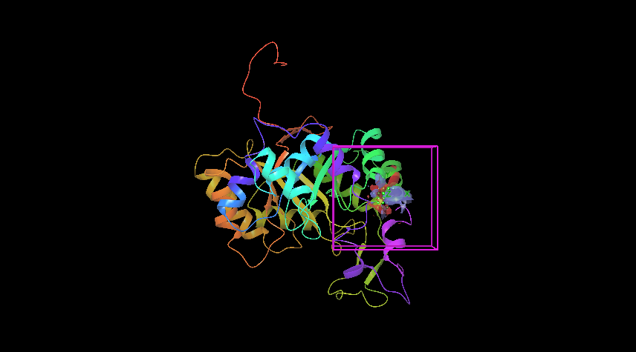
Os05t0474600 Active site 3

Slide 6
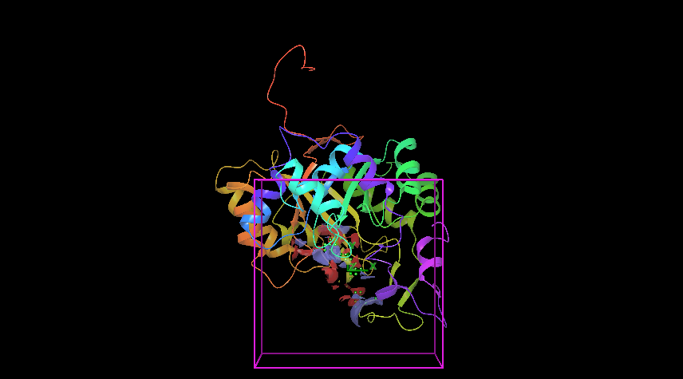
Os05t0474600 Active site 4

Slide 7
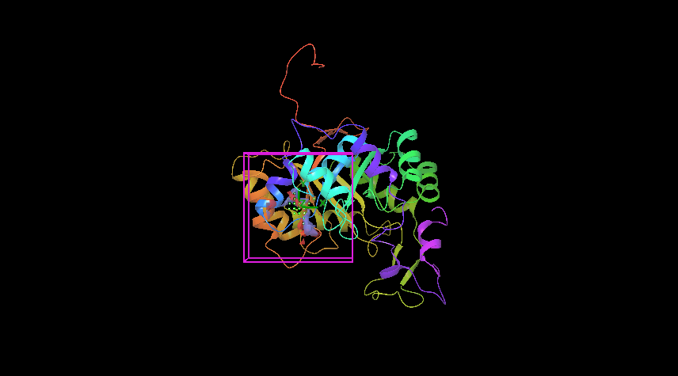
Os05t0474600 Active site 5

Slide 8
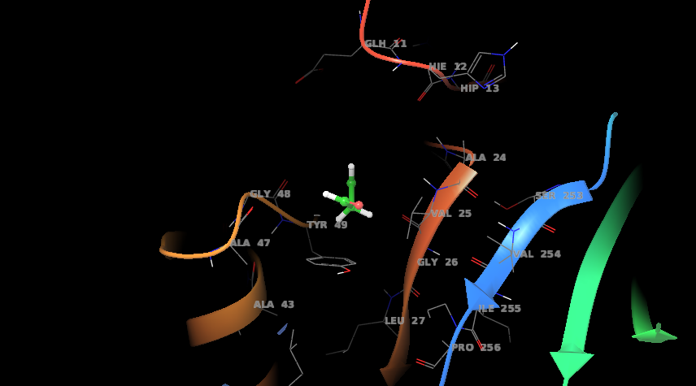
Os05t0474600 docked with malonialdehyde

Slide 9
Initial observation
Different active sites on any given protein (AKR) show differential binding ability with different RCC’s.
Binding with high efficency:
Glycoldehyde
Malondialdehyde
Glucosone
Binding with least efficiency:
Acrolein
Glyoxal
Crotonaldehyde

Slide 10
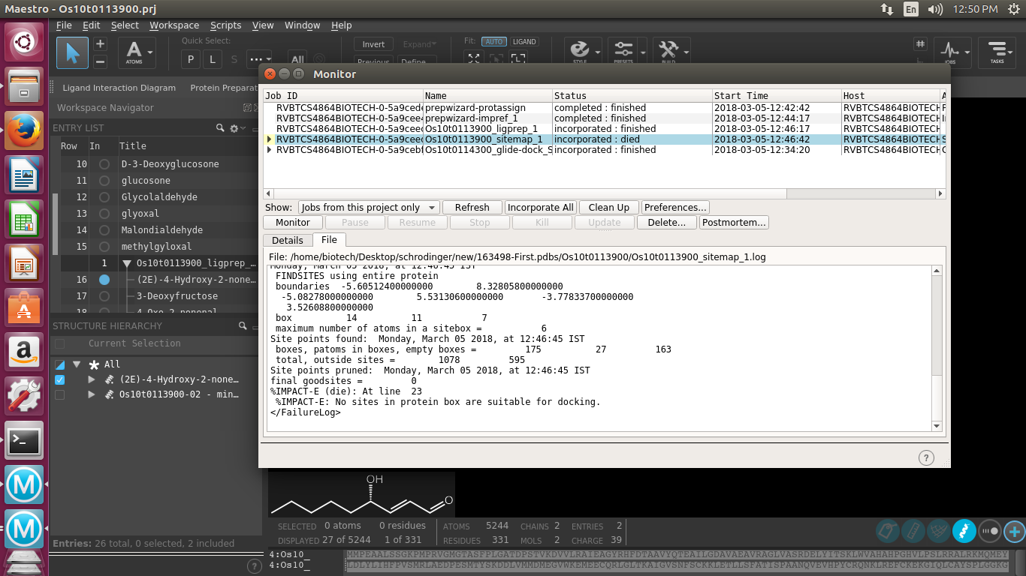

Slide 12
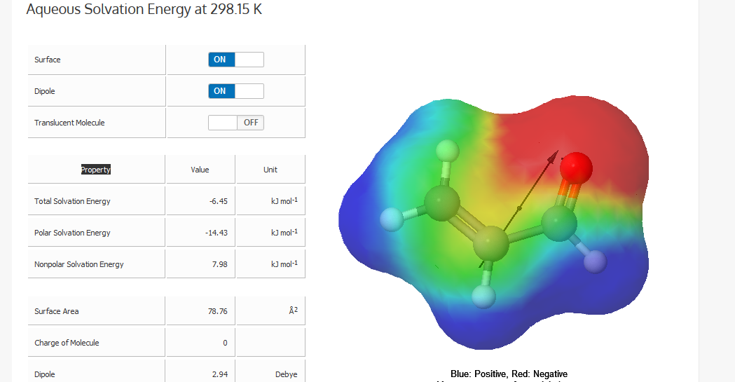
Acrolein

Slide 13
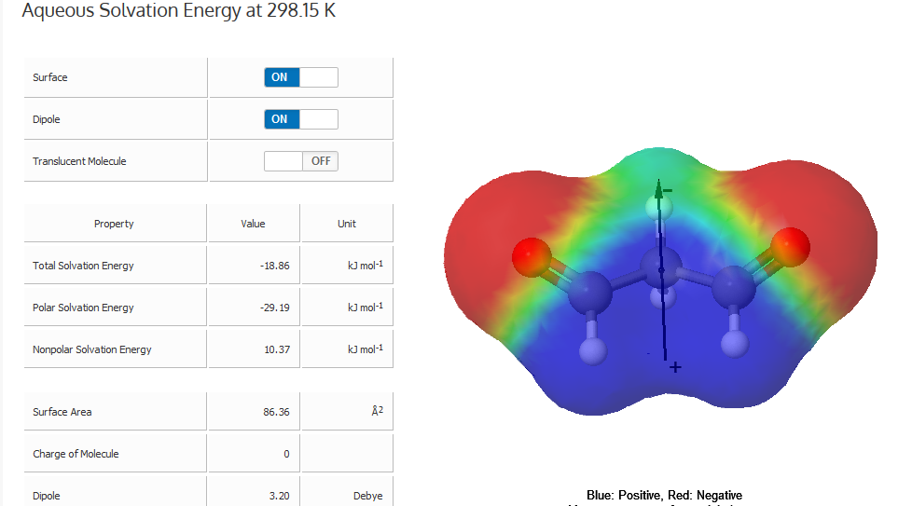
Malondialdehyde

